Slide 1

Training React 30-11-2018

Slide 2
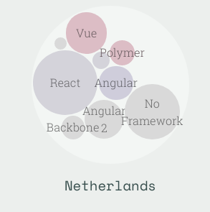
React
First version: May 2013
Created by Facebook
Most popular JS framework
Unopinionated
Single Page Applications
Component based
Spawned React Native
Awesome
Stateofjs.com
React
1

Slide 3
Components
Components:
Are reusable blocks of code
Render JSX
Can be passed properties when called
Have their own state
Have a parent – child relation
React
1

Slide 4

Components
Tweakers.net
React
1

Slide 5
Components
Components:
Are reusable blocks of code
Render JSX
Can be passed properties when called
Have their own state
Have a parent – child relation
React
1

Slide 6
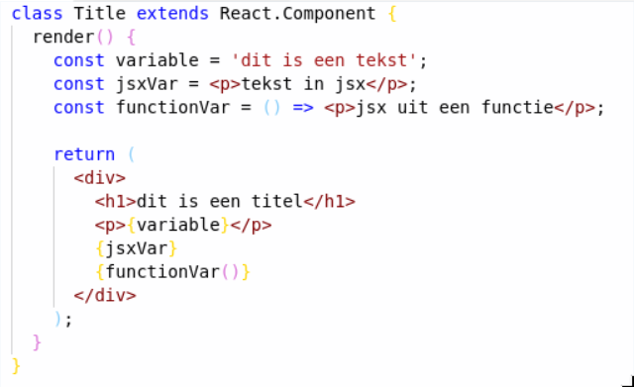
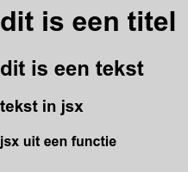
JSX
React
1

Slide 7
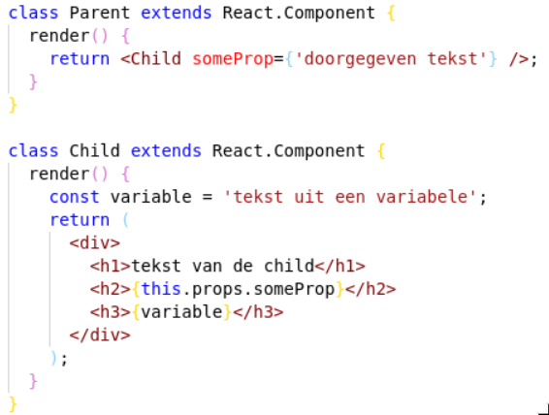

Props
React
1

Slide 8
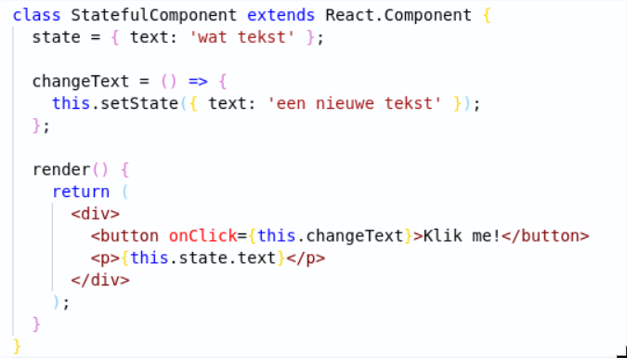


State
React
1

Slide 9

Hands-on Time!
Questions?
React
<number>

Slide 10
Hands-on: Editing JSX
Suggestion: use VS Code with ESlint plugin for error-checking
Git clone https://github.com/AMIS-Services/react-series
Cd into dir exercise, run `yarn install` and `yarn start`
Inspect the page in your browser
Edit the JSX in the file src/App.js to show AMISBnB as a title
React
<number>

Slide 11
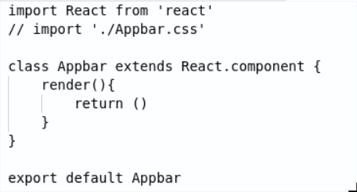
Hands-on: Creating a component
Create the folder src/components
Create a new component by adding a file named Appbar.js with the code shown below.
Add JSX to the return of the render method.
Add some styling in a .css file and import the css file
Import and use the component in src/App.js
React
<number>

Slide 12
Hands-on: passing props to your component
Pass a prop to your Appbar: `<Appbar propName=’a string’ />`
Use this prop in the Appbar (availabe with `this.props.propName`)
Try using multiple Appbar components in your App.js with different values for your prop
React
<number>

Slide 13
Hands-on: displaying data
Import the data from the resources folder: `import { accomodations } from ‘src/resources/accommodations.js’`
Use accommodations.map((accommodation) => { return ...}) to display a div with the accommodations name for each accommodation
Move the rendering of the accommodations to a separate function called renderAccommodations which should JSX. Use it by changing the map function to: `accommodations.map(this.renderAccomodations)`
Display more of the data from the accommodations objects. Add some styling.
React
<number>

Slide 14
Hands-on: move accommodation to it’s own component
Create a new .js and .css file for AccommodationCard. Add the required code to export a component from these files and move the rendering of an accommodation to this component.
Move the css you used to style the individial accommodations from Accommodations.css to the new css file
Display the component <HomeIcon /> from the resources folder in your new Accomodation component. Have its color be based on favorite being true or false.
React
<number>

Slide 15
Hands-on: using state
Have the HomeIcon be shown dependent on state rather than props by adding a this.state.favorite to your AccommodationCard component
Add a function to your component which toggles the value of this.state.favorite using `this.setState()`
Add an `onClick` property to your HomeIcon which calls the function you just wrote
React
<number>

Slide 16
Hands-on extra: displaying favorites at the top
Display the accommodations which have `favorite === true` a second time at the top of the page
Make sure that the toggleState will still work by keeping the state in the parent component and passing down the toggle function to the child
React
<number>

